Slide 1
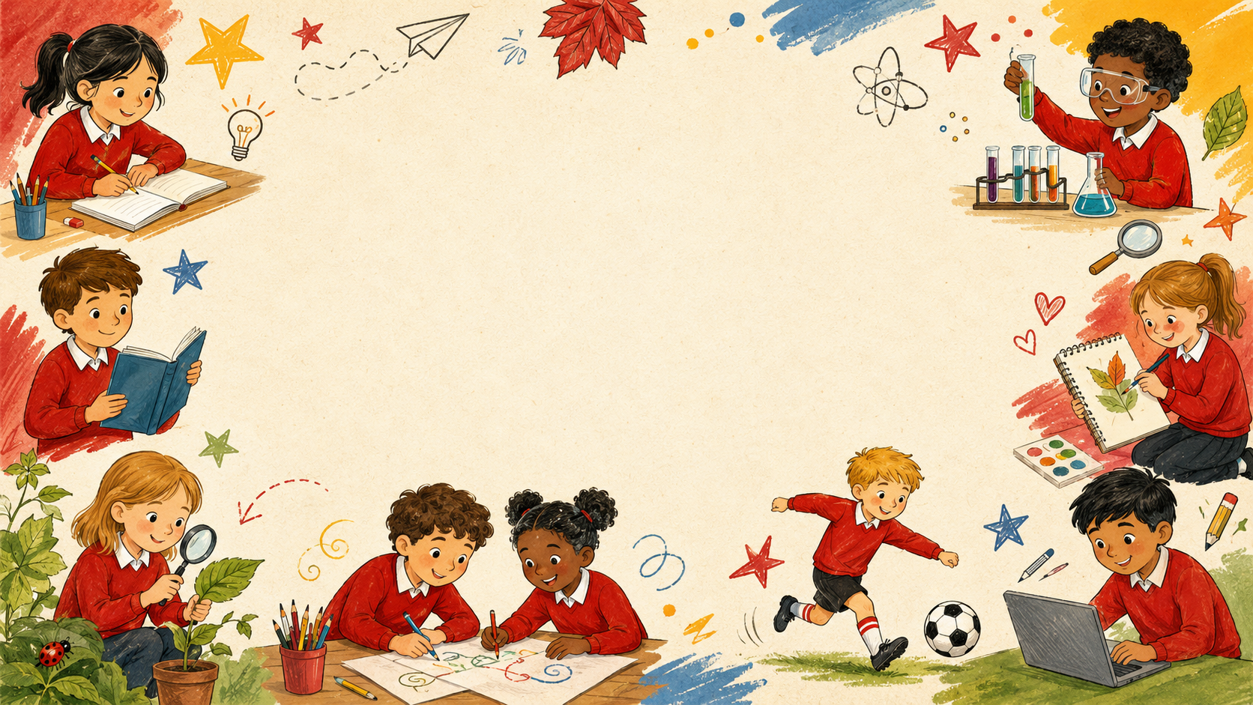

Class 2 Personal Passport
Church Eaton Primary School
Across the year we complete lots of exciting challenges. We build confidence, learn to make thoughtful choices, help our communities, look after our wellbeing and practise skills that prepare us for the future.
Each page has space for a photo so we can celebrate our achievements and keep a record of what we have completed.
The passport headings help us learn skills for adult life: ambition, responsibility, respect for difference, healthy minds and bodies, active choices and everyday independence.
Curriculum • Diversity • Social Mobility

Slide 2
Ambition for the future
Church Eaton
We build confidence for our next steps, learn about choices, set goals and keep trying when learning feels tricky.
Page 1 of 3
I am prepared for the next stage in my education.
I understand that there are a range of career choices.
I can make sensible choices about what to spend my money on.
I am getting ready for new learning and feeling confident about what comes next.
I am learning that people can choose many different jobs and pathways.
I can think carefully before spending money and make sensible choices.
PHOTO
PHOTO
PHOTO
School Pillars: Curriculum • Diversity • Social Mobility

Slide 3
Ambition for the future
Church Eaton
We build confidence for our next steps, learn about choices, set goals and keep trying when learning feels tricky.
Page 2 of 3
I can take turns and listen to my teams.
I don’t give up when things get difficult.
I set a goal and work hard to achieve it.
I can listen to others and work as part of a team.
I can keep going and try different ways when things feel hard.
I can choose something to improve and work towards it step by step.
PHOTO
PHOTO
PHOTO
School Pillars: Curriculum • Diversity • Social Mobility

Slide 4
Ambition for the future
Church Eaton
We build confidence for our next steps, learn about choices, set goals and keep trying when learning feels tricky.
Page 3 of 3
I know what British values are.
I respect difference.
I have held a role of responsibility in the classroom.
I can understand the values that help people live and learn together.
I can respect people’s differences and learn from others.
I can take responsibility and help our class run smoothly.
PHOTO
PHOTO
PHOTO
School Pillars: Curriculum • Diversity • Social Mobility

Slide 5
Courageous Advocacy
Church Eaton
We use our voices and actions to make positive choices for our school, our community and the wider world.
Page 1 of 4
I am a good friend.
I make a positive contribution to the school community.
I make a positive contribution to the local community.
I can be kind, include others and make positive choices with friends.
I can help make our school a better place for everyone.
I can think about ways to help the people and places near us.
PHOTO
PHOTO
PHOTO
School Pillars: Curriculum • Diversity • Social Mobility

Slide 6
Courageous Advocacy
Church Eaton
We use our voices and actions to make positive choices for our school, our community and the wider world.
Page 2 of 4
I make a positive contribution to the global community.
I look after wildlife in the school community.
I play my part in protecting the environment in everyday life.
I can understand that my choices can affect people and places around the world.
I can help make our school a better place for everyone.
I can make everyday choices that help look after our planet.
PHOTO
PHOTO
PHOTO
School Pillars: Curriculum • Diversity • Social Mobility

Slide 7
Courageous Advocacy
Church Eaton
We use our voices and actions to make positive choices for our school, our community and the wider world.
Page 3 of 4
Be a changemaker in my school.
I know people have different views to mine.
I can disagree respectfully.
I can spot something that could be better and take action.
I can listen to opinions that are different from my own.
I can disagree politely and still show respect.
PHOTO
PHOTO
PHOTO
School Pillars: Curriculum • Diversity • Social Mobility

Slide 8
Courageous Advocacy
Church Eaton
We use our voices and actions to make positive choices for our school, our community and the wider world.
Page 4 of 4
I have visited a place of worship
I have experienced an aspect of a culture different to my own.
I can learn about special places and what they mean to people.
I can learn about traditions and experiences that may be different from mine.
PHOTO
PHOTO
School Pillars: Curriculum • Diversity • Social Mobility

Slide 9
Happy Mind, Happy Me
Church Eaton
We learn to understand feelings, manage worries, use helpful strategies and notice what makes us feel happy and safe.
Page 1 of 5
I can identify a range of feelings in myself and others.
I know and can use a range of emotion vocabulary
I have a strategy to support my own feelings and the feelings of others.
I can notice feelings in myself and others.
I can use a wider range of words to explain how I feel.
I can notice feelings in myself and others.
PHOTO
PHOTO
PHOTO
School Pillars: Curriculum • Diversity • Social Mobility

Slide 10
Happy Mind, Happy Me
Church Eaton
We learn to understand feelings, manage worries, use helpful strategies and notice what makes us feel happy and safe.
Page 2 of 5
I know things that make me happy.
I have designed a bedtime checklist to help me have a good night’s sleep.
I have followed my bedtime checklist as often as I can.
I can recognise what helps me feel happy and well.
I can understand how sleep routines support my health.
I can understand how sleep routines support my health.
PHOTO
PHOTO
PHOTO
School Pillars: Curriculum • Diversity • Social Mobility

Slide 11
Happy Mind, Happy Me
Church Eaton
We learn to understand feelings, manage worries, use helpful strategies and notice what makes us feel happy and safe.
Page 3 of 5
I know what to do when I feel worried.
I can recognise signs that I feel worried or anxious.
I regularly spend time in nature in all weathers.
I can spot signs of worry and know what might help.
I can spot signs of worry and know what might help.
I can think carefully before spending money and make sensible choices.
PHOTO
PHOTO
PHOTO
School Pillars: Curriculum • Diversity • Social Mobility

Slide 12
Happy Mind, Happy Me
Church Eaton
We learn to understand feelings, manage worries, use helpful strategies and notice what makes us feel happy and safe.
Page 4 of 5
I recognise the wonders of nature.
I have visited a gallery.
I have visited a museum.
I can spend time in nature and notice the world around me.
I can experience arts, culture and learning beyond the classroom.
I can experience arts, culture and learning beyond the classroom.
PHOTO
PHOTO
PHOTO
School Pillars: Curriculum • Diversity • Social Mobility

Slide 13
Happy Mind, Happy Me
Church Eaton
We learn to understand feelings, manage worries, use helpful strategies and notice what makes us feel happy and safe.
Page 5 of 5
I have visited a theatre.
I can experience arts, culture and learning beyond the classroom.
PHOTO
School Pillars: Curriculum • Diversity • Social Mobility

Slide 14
Keeping Physically Active
Church Eaton
We stay active, try new challenges, work as a team and learn how movement helps our bodies and minds.
Page 1 of 5
I have taken part in an extra-curricular physical activity.
I have taken part in a competitive sport.
I have taken part in a team sport.
I can join in with active opportunities beyond lessons.
I can take part, try my best and show good sportsmanship.
I can cooperate, encourage others and play fairly as a team.
PHOTO
PHOTO
PHOTO
School Pillars: Curriculum • Diversity • Social Mobility

Slide 15
Keeping Physically Active
Church Eaton
We stay active, try new challenges, work as a team and learn how movement helps our bodies and minds.
Page 2 of 5
I can celebrate wins and manage defeats appropriately.
I have designed an exercise diary to include 15mins of physical activity everyday.
I have designed an exercise diary to include 30mins of physical activity everyday.
I can enjoy success and manage disappointment positively.
I can plan daily movement and track my active choices.
I can plan daily movement and track my active choices.
PHOTO
PHOTO
PHOTO
School Pillars: Curriculum • Diversity • Social Mobility

Slide 16
Keeping Physically Active
Church Eaton
We stay active, try new challenges, work as a team and learn how movement helps our bodies and minds.
Page 3 of 5
I have designed an exercise diary to include 45mins of physical activity everyday.
I have designed an exercise diary to include 60mins of physical activity everyday.
I have completed my diary.
I can plan daily movement and track my active choices.
I can plan daily movement and track my active choices.
I can stick with a challenge and celebrate my progress.
PHOTO
PHOTO
PHOTO
School Pillars: Curriculum • Diversity • Social Mobility

Slide 17
Keeping Physically Active
Church Eaton
We stay active, try new challenges, work as a team and learn how movement helps our bodies and minds.
Page 4 of 5
I regularly spend time in nature.
I recognise the wonder of nature.
Play a new playground game.
I can think carefully before spending money and make sensible choices.
I can spend time in nature and notice the world around me.
I can learn a new active game and teach it to others.
PHOTO
PHOTO
PHOTO
School Pillars: Curriculum • Diversity • Social Mobility

Slide 18
Keeping Physically Active
Church Eaton
We stay active, try new challenges, work as a team and learn how movement helps our bodies and minds.
Page 5 of 5
I have tried a physical activity that I have never tried before.
I have walked some of the way to school.
I can try something new and be brave with active challenges.
I can make active choices as part of my day.
PHOTO
PHOTO
School Pillars: Curriculum • Diversity • Social Mobility

Slide 19
Life Skills
Church Eaton
We practise practical skills that help us become more independent, responsible and ready for everyday life.
Page 1 of 3
I know how to wash my hands.
I know how to use a knife and fork.
I know how to tie my shoelaces.
I can keep myself and others healthy with good hygiene.
I can use cutlery safely and with independence.
I can practise a skill that helps me be more independent.
PHOTO
PHOTO
PHOTO
School Pillars: Curriculum • Diversity • Social Mobility

Slide 20
Life Skills
Church Eaton
We practise practical skills that help us become more independent, responsible and ready for everyday life.
Page 2 of 3
I know how to fasten my coat.
I know what an animal needs to stay healthy.
I am learning to play a musical instrument.
I can get ready independently for outdoor learning and play.
I can understand how to care for living things.
I can develop patience and confidence through music.
PHOTO
PHOTO
PHOTO
School Pillars: Curriculum • Diversity • Social Mobility

Slide 21
Life Skills
Church Eaton
We practise practical skills that help us become more independent, responsible and ready for everyday life.
Page 3 of 3
I know basic first aid.
I know how to cross a road safely.
I can follow a basic recipe with some support.
I can learn how to help safely in simple first aid situations.
I can make safe choices when near roads.
I can follow instructions and make something with support.
PHOTO
PHOTO
PHOTO
School Pillars: Curriculum • Diversity • Social Mobility

Slide 22
Celebrating our passport journey
Church Eaton
A final celebration page to showcase special moments from our passport journey.
Page 1 of 1
A proud moment
A new skill
A way we helped
I am practising a skill that helps me grow in confidence and independence.
I am practising a skill that helps me grow in confidence and independence.
I am practising a skill that helps me grow in confidence and independence.
PHOTO
PHOTO
PHOTO
School Pillars: Curriculum • Diversity • Social Mobility

