Slide 1
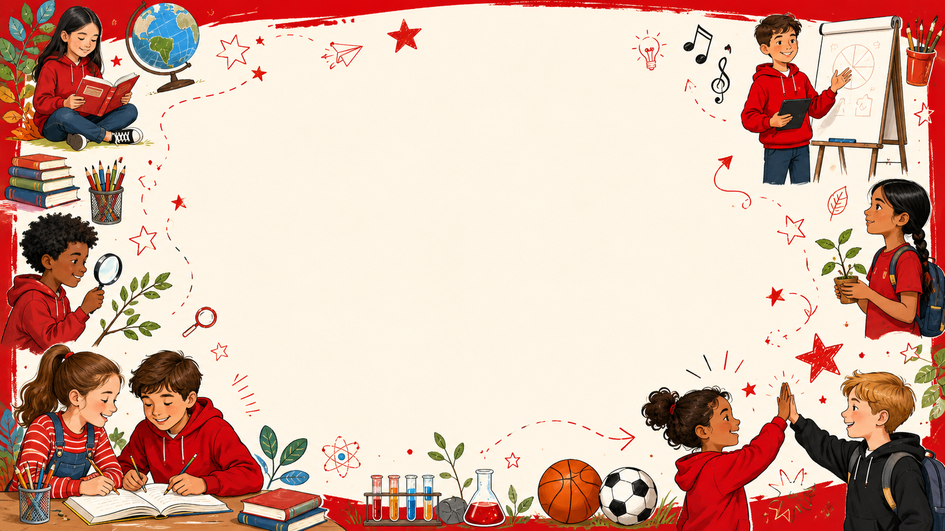

Class 3 Personal Passport
Church Eaton Primary School
Across the year we complete lots of exciting challenges. We build confidence, take responsibility, make thoughtful choices, help our communities, look after our wellbeing and practise skills that prepare us for the future. Each page has space for a photo so we can celebrate our achievements and keep a record of what we have completed.
The passport headings help us learn skills for adult life: ambition, responsibility, respect for difference, healthy minds and bodies, active choices and everyday independence.

Slide 2
Ambition for the future
We build confidence for our next steps, learn about choices, set goals and keep trying when learning feels tricky.
Class 3 • 1
I have held a role of responsibility in school.
I am prepared for the next stage in my education.
I understand that there are a range of career choices.
I can take responsibility and help our class run smoothly.
I am getting ready for new learning and feeling confident about what comes next.
I am learning that people can choose many different jobs and pathways.
Photo
Photo
Photo
School Pillars
Curriculum
Diversity
Social Mobility

Slide 3
Ambition for the future
We build confidence for our next steps, learn about choices, set goals and keep trying when learning feels tricky.
Class 3 • 2
I can make sensible choices about what to spend and what to save.
I can take the lead within a team.
I can share my views with my team.
I can think carefully before spending money and make sensible choices.
I am practising a skill that helps me grow in confidence and independence.
I am practising a skill that helps me grow in confidence and independence.
Photo
Photo
Photo
School Pillars
Curriculum
Diversity
Social Mobility

Slide 4
Ambition for the future
We build confidence for our next steps, learn about choices, set goals and keep trying when learning feels tricky.
Class 3 • 3
I know what British values are and give examples of them in school.
I understand discrimination is against the law.
I don’t give up when things are difficult.
I can understand the values that help people live and learn together.
I am practising a skill that helps me grow in confidence and independence.
I can keep going and try different ways when things feel hard.
Photo
Photo
Photo
School Pillars
Curriculum
Diversity
Social Mobility

Slide 5
Ambition for the future
We build confidence for our next steps, learn about choices, set goals and keep trying when learning feels tricky.
Class 3 • 4
I set a goal and identify the steps necessary to achieve it.
I can choose something to improve and work towards it step by step.
Photo
School Pillars
Curriculum
Diversity
Social Mobility

Slide 6
Courageous Advocacy
We use our voices and actions to make positive choices for our school, our community and the wider world.
Class 3 • 5
I practise empathy in my relationships.
I look after wildlife in the school and the local community.
I play my part in protecting the environment in everyday life.
I am practising a skill that helps me grow in confidence and independence.
I can think about ways to help the people and places near us.
I can make everyday choices that help look after our planet.
Photo
Photo
Photo
School Pillars
Curriculum
Diversity
Social Mobility

Slide 7
Courageous Advocacy
We use our voices and actions to make positive choices for our school, our community and the wider world.
Class 3 • 6
I make a positive contribution to the school community.
I make a positive contribution to the local community.
I make a positive contribution to the global community.
I can help make our school a better place for everyone.
I can think about ways to help the people and places near us.
I can understand that my choices can affect people and places around the world.
Photo
Photo
Photo
School Pillars
Curriculum
Diversity
Social Mobility

Slide 8
Courageous Advocacy
We use our voices and actions to make positive choices for our school, our community and the wider world.
Class 3 • 7
I respect and understand people have different views to my own.
I can disagree respectfully.
I have visited a variety of places of worship
I can listen to opinions that are different from my own.
I can disagree politely and still show respect.
I am practising a skill that helps me grow in confidence and independence.
Photo
Photo
Photo
School Pillars
Curriculum
Diversity
Social Mobility

Slide 9
Courageous Advocacy
We use our voices and actions to make positive choices for our school, our community and the wider world.
Class 3 • 8
I have experienced an aspect of a culture different to my own.
I can learn about traditions and experiences that may be different from mine.
Photo
School Pillars
Curriculum
Diversity
Social Mobility

Slide 10
Happy Mind, Happy Me
We learn to understand feelings, manage worries, use helpful strategies and notice what makes us feel happy and safe.
Class 3 • 9
I can recognise and support myself and others when experiencing a range of different emotions.
I have an increasing range of strategies to support myself and others when experiencing a range of different emotions.
I know the things that make me happy.
I am practising a skill that helps me grow in confidence and independence.
I am practising a skill that helps me grow in confidence and independence.
I can recognise what helps me feel happy and well.
Photo
Photo
Photo
School Pillars
Curriculum
Diversity
Social Mobility

Slide 11
Happy Mind, Happy Me
Class 3 • 10
We learn to understand feelings, manage worries, use helpful strategies and notice what makes us feel happy and safe.
I have designed a bedtime checklist to help me have a good night’s sleep.
I have followed my bedtime checklist as often as I can.
I know and can use a range of emotion vocabulary.
I can understand how sleep routines support my health.
I can understand how sleep routines support my health.
I can use a wider range of words to explain how I feel.
Photo
Photo
Photo
School Pillars
Curriculum
Diversity
Social Mobility

Slide 12
Happy Mind, Happy Me
We learn to understand feelings, manage worries, use helpful strategies and notice what makes us feel happy and safe.
Class 3 • 11
I regularly practice mindfulness and understand its importance.
I know who can help me when I feel worried and can use strategies to support myself.
I regularly spend time in nature in all weathers.
I am practising a skill that helps me grow in confidence and independence.
I can spot signs of worry and know what might help.
I can think carefully before spending money and make sensible choices.
Photo
Photo
Photo
School Pillars
Curriculum
Diversity
Social Mobility

Slide 13
Happy Mind, Happy Me
Class 3 • 12
We learn to understand feelings, manage worries, use helpful strategies and notice what makes us feel happy and safe.
I recognise the wonders of nature.
I have visited a gallery and can discuss my preferences.
I have visited a museum and can reflect on exhibits.
I can spend time in nature and notice the world around me.
I can experience arts, culture and learning beyond the classroom.
I can experience arts, culture and learning beyond the classroom.
Photo
Photo
Photo
School Pillars
Curriculum
Diversity
Social Mobility

Slide 14
Happy Mind, Happy Me
We learn to understand feelings, manage worries, use helpful strategies and notice what makes us feel happy and safe.
Class 3 • 13
I have visited a theatre and can review the performance.
I can experience arts, culture and learning beyond the classroom.
Photo
School Pillars
Curriculum
Diversity
Social Mobility

Slide 15
Keeping Physically Active
We stay active, try new challenges, work as a team and learn how movement helps our bodies and minds.
Class 3 • 14
I have taken part in an extra-curricular physical activity.
I have taken part in a competitive sport.
I have taken part in a team sport.
I can join in with active opportunities beyond lessons.
I can take part, try my best and show good sportsmanship.
I can cooperate, encourage others and play fairly as a team.
Photo
Photo
Photo
School Pillars
Curriculum
Diversity
Social Mobility

Slide 16
Keeping Physically Active
We stay active, try new challenges, work as a team and learn how movement helps our bodies and minds.
Class 3 • 15
I can celebrate wins and manage defeats appropriately.
I have held a role of responsibility at playtimes/lunchtimes
I have designed an exercise diary to include 15mins of physical activity everyday.
I can enjoy success and manage disappointment positively.
I can take responsibility and help our class run smoothly.
I can plan daily movement and track my active choices.
Photo
Photo
Photo
School Pillars
Curriculum
Diversity
Social Mobility

Slide 17
Keeping Physically Active
We stay active, try new challenges, work as a team and learn how movement helps our bodies and minds.
Class 3 • 16
I have designed an exercise diary to include 30mins of physical activity everyday.
I have designed an exercise diary to include 45mins of physical activity everyday.
I have designed an exercise diary to include 60mins of physical activity everyday.
I can plan daily movement and track my active choices.
I can plan daily movement and track my active choices.
I can plan daily movement and track my active choices.
Photo
Photo
Photo
School Pillars
Curriculum
Diversity
Social Mobility

Slide 18
Keeping Physically Active
We stay active, try new challenges, work as a team and learn how movement helps our bodies and minds.
Class 3 • 17
I have completed my diary and shared the impact.
I regularly spend time in nature in all weathers.
I recognise the wonders of nature.
I can stick with a challenge and celebrate my progress.
I can think carefully before spending money and make sensible choices.
I can spend time in nature and notice the world around me.
Photo
Photo
Photo
School Pillars
Curriculum
Diversity
Social Mobility

Slide 19
Keeping Physically Active
We stay active, try new challenges, work as a team and learn how movement helps our bodies and minds.
Class 3 • 18
Design a new playground game.
I have tried a physical activity that I have never tried before.
I have walked some of the way to school.
I can learn a new active game and teach it to others.
I can try something new and be brave with active challenges.
I can make active choices as part of my day.
Photo
Photo
Photo
School Pillars
Curriculum
Diversity
Social Mobility

Slide 20
Keeping Physically Active
We stay active, try new challenges, work as a team and learn how movement helps our bodies and minds.
Class 3 • 19
I have completed Bikeability.
I am practising a skill that helps me grow in confidence and independence.
Photo
School Pillars
Curriculum
Diversity
Social Mobility

Slide 21
Life Skills
We practise practical skills that help us become more independent, responsible and ready for everyday life.
Class 3 • 20
I am learning to play an instrument.
I have played an instrument in front of an audience.
I have presented information to an audience.
I am practising a skill that helps me grow in confidence and independence.
I am practising a skill that helps me grow in confidence and independence.
I am practising a skill that helps me grow in confidence and independence.
Photo
Photo
Photo
School Pillars
Curriculum
Diversity
Social Mobility

Slide 22
Life Skills
We practise practical skills that help us become more independent, responsible and ready for everyday life.
Class 3 • 21
I can use some basic tools.
I don’t give up and can find different ways to solve a problem.
I can follow a recipe with some support.
I am practising a skill that helps me grow in confidence and independence.
I can keep going and try different ways when things feel hard.
I can follow instructions and make something with support.
Photo
Photo
Photo
School Pillars
Curriculum
Diversity
Social Mobility

Slide 23
Life Skills
We practise practical skills that help us become more independent, responsible and ready for everyday life.
Class 3 • 22
I know what I am good at and what I need to get better at.
I know how to alert the emergency services.
I can tie my shoe laces.
I am practising a skill that helps me grow in confidence and independence.
I am practising a skill that helps me grow in confidence and independence.
I am practising a skill that helps me grow in confidence and independence.
Photo
Photo
Photo
School Pillars
Curriculum
Diversity
Social Mobility

Slide 24
Life Skills
We practise practical skills that help us become more independent, responsible and ready for everyday life.
Class 3 • 23
I know and can use a range of first aid techniques.
I can cross the road safely.
I have a taught a skill to someone else.
I can learn how to help safely in simple first aid situations.
I am practising a skill that helps me grow in confidence and independence.
I am practising a skill that helps me grow in confidence and independence.
Photo
Photo
Photo
School Pillars
Curriculum
Diversity
Social Mobility

Slide 25
Life Skills
We practise practical skills that help us become more independent, responsible and ready for everyday life.
Class 3 • 24
I can use a map to find my way.
I have grown a plant and used gardening equipment safely.
I am practising a skill that helps me grow in confidence and independence.
I am practising a skill that helps me grow in confidence and independence.
Photo
Photo
School Pillars
Curriculum
Diversity
Social Mobility

Slide 26
Celebrating our passport journey
Class 3 • 25
A proud moment
A new skill
A way we helped
I am practising a skill that helps me grow in confidence and independence.
I am practising a skill that helps me grow in confidence and independence.
I am practising a skill that helps me grow in confidence and independence.
Photo
Photo
Photo
School Pillars
Curriculum
Diversity
Social Mobility

