Slide 1
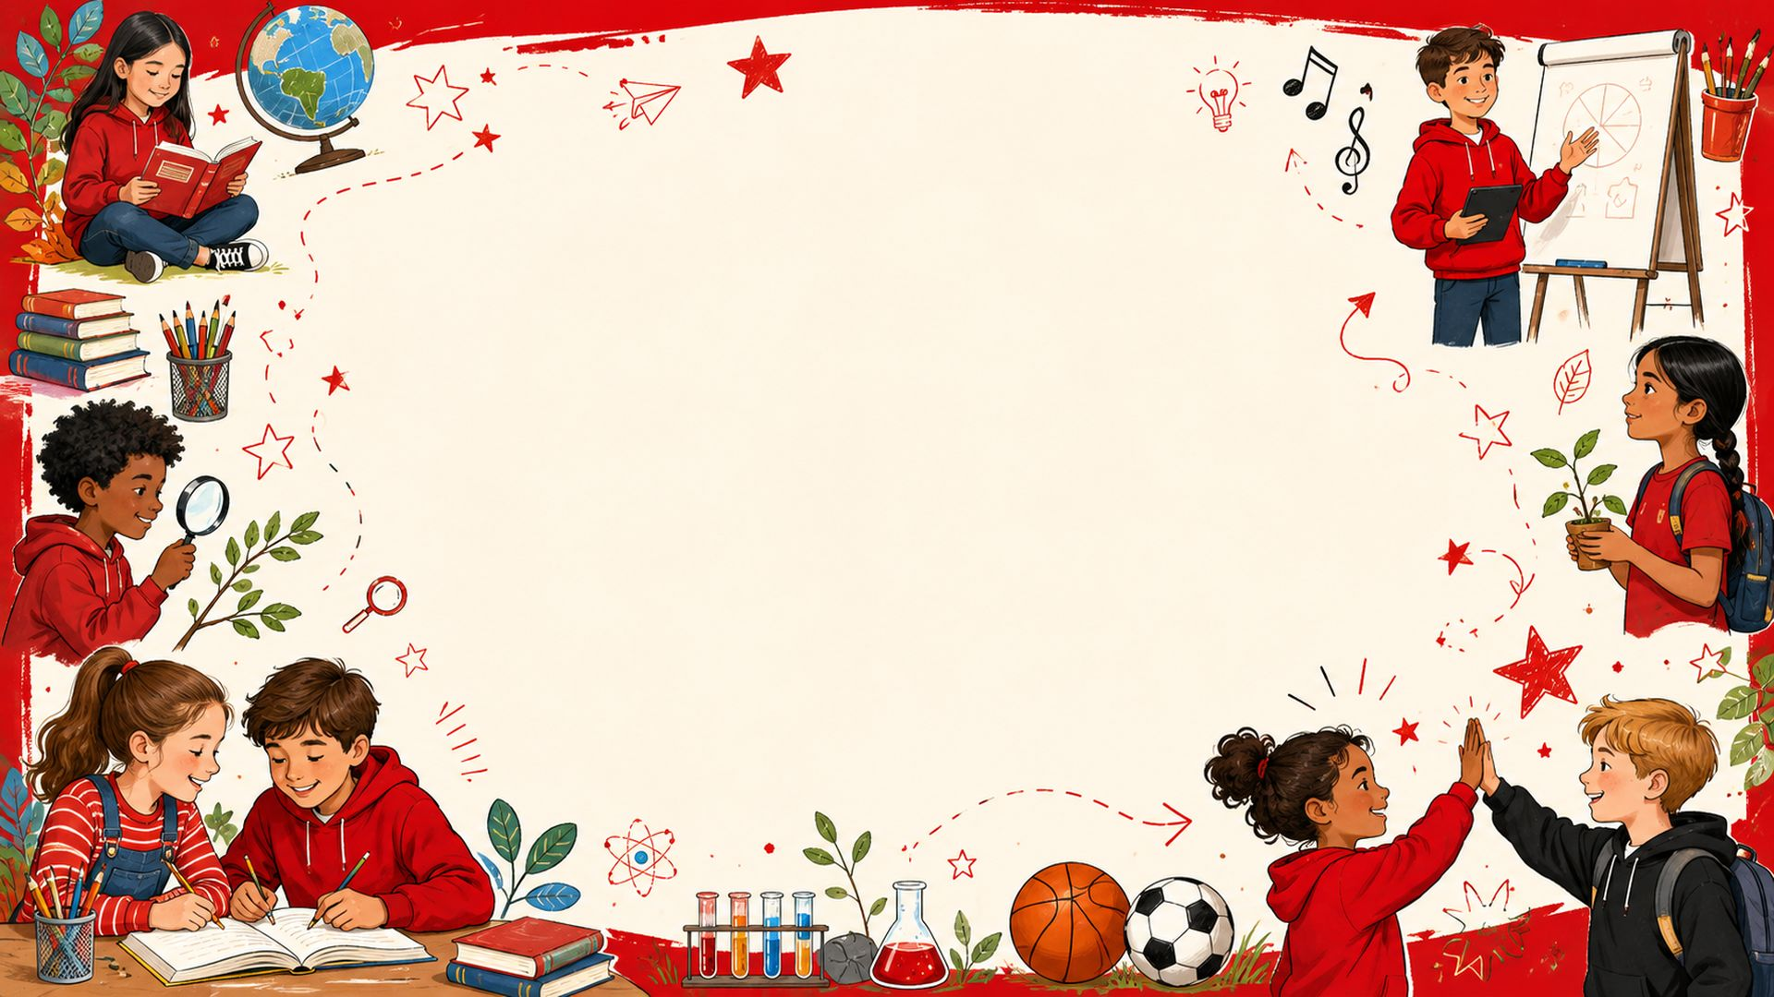

Class 4 Personal Passport
Church Eaton Primary School
Throughout the year, pupils complete a wide range of passport challenges. Each challenge helps them build confidence, independence, responsibility and care for others. The headings show how our passport supports pupils to grow as learners and as people, helping them prepare for life beyond primary school and for being thoughtful, active adults.
Curriculum • Diversity • Social Mobility

Slide 2
Ambition for the future
We build confidence, responsibility and aspirations so pupils can look ahead and take positive steps towards their future.
Class 4 • 1
I have held a role of responsibility.
I am prepared for the next stage in my education.
I understand that there are a range of career choices.
Developing leadership, trust and reliability through meaningful roles in school.
Preparing for change by understanding what comes next and how to be ready.
Learning that there are many exciting pathways and choices for the future.
School Pillars
Curriculum
Diversity
Social Mobility

Slide 3
Ambition for the future
We build confidence, responsibility and aspirations so pupils can look ahead and take positive steps towards their future.
Class 4 • 2
I understand the options available to me in the future.
I can budget for the future.
I can compromise.
Learning that there are many exciting pathways and choices for the future.
Learning that there are many exciting pathways and choices for the future.
Working with others by listening, contributing and finding shared solutions.
School Pillars
Curriculum
Diversity
Social Mobility

Slide 4
Ambition for the future
We build confidence, responsibility and aspirations so pupils can look ahead and take positive steps towards their future.
Class 4 • 3
I can take the lead within a team.
I can share my views with my team.
I know what British values are, give examples of them in school and why they are important.
Working with others by listening, contributing and finding shared solutions.
Working with others by listening, contributing and finding shared solutions.
Understanding respect, democracy, rule of law, liberty and tolerance in school life.
School Pillars
Curriculum
Diversity
Social Mobility

Slide 5
Ambition for the future
We build confidence, responsibility and aspirations so pupils can look ahead and take positive steps towards their future.
Class 4 • 4
I understand discriminate against anyone because of protected characteristics.
I don’t give up when things are difficult.
I set long term goals, with timescales and work hard to achieve them.
Recognising fairness and equality, and knowing everyone should be treated with respect.
Building resilience by trying different approaches and keeping going when things are hard.
Building resilience by trying different approaches and keeping going when things are hard.
School Pillars
Curriculum
Diversity
Social Mobility

Slide 6
Courageous Advocacy
We learn to speak up, care for others and make positive changes in our school, local community and wider world.
Class 4 • 5
I practise empathy in my relationships.
I am a changemaker and I understand the impact that I have made.
I look after wildlife in the school, local and global community.
Respecting other people, listening carefully and responding kindly even when opinions differ.
Taking action to make a positive difference to people and places around us.
Caring for the natural world and noticing how our choices can protect it.
School Pillars
Curriculum
Diversity
Social Mobility

Slide 7
Courageous Advocacy
We learn to speak up, care for others and make positive changes in our school, local community and wider world.
Class 4 • 6
I play my part in protecting the environment in everyday life.
I make a positive contribution to the school community.
I make a positive contribution to the local community.
Caring for the natural world and noticing how our choices can protect it.
Taking action to make a positive difference to people and places around us.
Taking action to make a positive difference to people and places around us.
School Pillars
Curriculum
Diversity
Social Mobility

Slide 8
Courageous Advocacy
We learn to speak up, care for others and make positive changes in our school, local community and wider world.
Class 4 • 7
I make a positive contribution to the global community.
I respect and understand that people have different views to my own.
I can disagree respectfully.
Taking action to make a positive difference to people and places around us.
Respecting other people, listening carefully and responding kindly even when opinions differ.
Respecting other people, listening carefully and responding kindly even when opinions differ.
School Pillars
Curriculum
Diversity
Social Mobility

Slide 9
Courageous Advocacy
We learn to speak up, care for others and make positive changes in our school, local community and wider world.
Class 4 • 8
I have visited a variety of places of worship.
I have experienced an aspect of culture different to my own.
Broadening understanding by learning about different beliefs, cultures and communities.
Broadening understanding by learning about different beliefs, cultures and communities.
School Pillars
Curriculum
Diversity
Social Mobility

Slide 10
Happy Mind, Happy Me
We explore emotions, wellbeing and self-care so pupils know how to look after themselves and support others.
Class 4 • 9
I have a range of strategies to help myself and others regulate.
I have regular opportunities to practice strategies to regulate.
I know the things that make me happy
Recognising feelings and choosing helpful strategies to stay calm, safe and ready to learn.
Recognising feelings and choosing helpful strategies to stay calm, safe and ready to learn.
Reflecting on positive experiences and knowing what helps us feel happy and well.
School Pillars
Curriculum
Diversity
Social Mobility

Slide 11
Happy Mind, Happy Me
We explore emotions, wellbeing and self-care so pupils know how to look after themselves and support others.
Class 4 • 10
I have designed a night time checklist to help me have a good night’s sleep.
I have followed my night time checklist as often as I can.
I know and can use a range of emotion vocabulary.
Understanding healthy routines that support rest, wellbeing and learning.
Understanding healthy routines that support rest, wellbeing and learning.
Recognising feelings and choosing helpful strategies to stay calm, safe and ready to learn.
School Pillars
Curriculum
Diversity
Social Mobility

Slide 12
Happy Mind, Happy Me
We explore emotions, wellbeing and self-care so pupils know how to look after themselves and support others.
Class 4 • 11
I regularly independently practise mindfulness and understand it’s impact.
I know who can help me when I feel worried and can use strategies to support myself.
I regularly spend time in nature in all weathers.
Recognising feelings and choosing helpful strategies to stay calm, safe and ready to learn.
Recognising feelings and choosing helpful strategies to stay calm, safe and ready to learn.
Making thoughtful choices with money and understanding saving, spending and planning.
School Pillars
Curriculum
Diversity
Social Mobility

Slide 13
Happy Mind, Happy Me
We explore emotions, wellbeing and self-care so pupils know how to look after themselves and support others.
Class 4 • 12
I recognise the wonders of nature.
I have visited a gallery and can discuss my preferences.
I have visited a museum and can reflect on its exhibits.
Caring for the natural world and noticing how our choices can protect it.
Experiencing arts and culture, then reflecting on what we noticed and enjoyed.
Experiencing arts and culture, then reflecting on what we noticed and enjoyed.
School Pillars
Curriculum
Diversity
Social Mobility

Slide 14
Happy Mind, Happy Me
We explore emotions, wellbeing and self-care so pupils know how to look after themselves and support others.
Class 4 • 13
I have visited a theatre and can review a performance.
Experiencing arts and culture, then reflecting on what we noticed and enjoyed.
School Pillars
Curriculum
Diversity
Social Mobility

Slide 15
Keeping Physically Active
We celebrate movement, teamwork and healthy habits through sport, play, outdoor learning and challenge.
Class 4 • 14
I have taken part in an extra-curricular physical activity.
I have taken part in a competitive sport.
I have taken part in a team sport.
Keeping active, trying new challenges and understanding how movement supports wellbeing.
Keeping active, trying new challenges and understanding how movement supports wellbeing.
Working with others by listening, contributing and finding shared solutions.
School Pillars
Curriculum
Diversity
Social Mobility

Slide 16
Keeping Physically Active
We celebrate movement, teamwork and healthy habits through sport, play, outdoor learning and challenge.
Class 4 • 15
I can celebrate wins and manage defeats appropriately.
I have held a role of responsibility at playtimes/lunchtimes.
I have designed an exercise diary to include 15mins of physical activity everyday.
We celebrate movement, teamwork and healthy habits through sport, play, outdoor learning and challenge.
Developing leadership, trust and reliability through meaningful roles in school.
Keeping active, trying new challenges and understanding how movement supports wellbeing.
School Pillars
Curriculum
Diversity
Social Mobility

Slide 17
Keeping Physically Active
We celebrate movement, teamwork and healthy habits through sport, play, outdoor learning and challenge.
Class 4 • 16
I have designed an exercise diary to include 30mins of physical activity everyday.
I have designed an exercise diary to include 45mins of physical activity everyday.
I have designed an exercise diary to include 60mins of physical activity everyday.
Keeping active, trying new challenges and understanding how movement supports wellbeing.
Keeping active, trying new challenges and understanding how movement supports wellbeing.
Keeping active, trying new challenges and understanding how movement supports wellbeing.
School Pillars
Curriculum
Diversity
Social Mobility

Slide 18
Keeping Physically Active
We celebrate movement, teamwork and healthy habits through sport, play, outdoor learning and challenge.
Class 4 • 17
I have completed my diary over a sustained period and shared the impact with an audience.
I regularly spend time in nature in all weathers.
I recognise the wonders of nature.
Keeping active, trying new challenges and understanding how movement supports wellbeing.
Making thoughtful choices with money and understanding saving, spending and planning.
Caring for the natural world and noticing how our choices can protect it.
School Pillars
Curriculum
Diversity
Social Mobility

Slide 19
Keeping Physically Active
We celebrate movement, teamwork and healthy habits through sport, play, outdoor learning and challenge.
Class 4 • 18
Organise a playground game for younger children.
I have tried a physical activity that I have never tried before.
I have walked some of the way to school.
Keeping active, trying new challenges and understanding how movement supports wellbeing.
Keeping active, trying new challenges and understanding how movement supports wellbeing.
Keeping active, trying new challenges and understanding how movement supports wellbeing.
School Pillars
Curriculum
Diversity
Social Mobility

Slide 20
Keeping Physically Active
We celebrate movement, teamwork and healthy habits through sport, play, outdoor learning and challenge.
Class 4 • 19
I have completed bikeability.
Keeping active, trying new challenges and understanding how movement supports wellbeing.
School Pillars
Curriculum
Diversity
Social Mobility

Slide 21
Life Skills
We practise practical skills that help pupils become more independent, safe, confident and ready for the next stage.
Class 4 • 20
I know the significant places in the local community.
I can follow a recipe independently.
I can find my way with a map and a compass.
We practise practical skills that help pupils become more independent, safe, confident and ready for the next stage.
Practising useful skills that build independence, safety and confidence in everyday life.
Practising useful skills that build independence, safety and confidence in everyday life.
School Pillars
Curriculum
Diversity
Social Mobility

Slide 22
Life Skills
We practise practical skills that help pupils become more independent, safe, confident and ready for the next stage.
Class 4 • 21
I can use some tools and manage the risks.
I have played an instrument in front of an audience.
I have presented information to an audience.
Practising useful skills that build independence, safety and confidence in everyday life.
Practising useful skills that build independence, safety and confidence in everyday life.
Practising useful skills that build independence, safety and confidence in everyday life.
School Pillars
Curriculum
Diversity
Social Mobility

Slide 23
Life Skills
We practise practical skills that help pupils become more independent, safe, confident and ready for the next stage.
Class 4 • 22
I am learning to play an instrument.
I can tie some useful knots.
I know what I am good at and what I need to get better at.
Practising useful skills that build independence, safety and confidence in everyday life.
Practising useful skills that build independence, safety and confidence in everyday life.
We practise practical skills that help pupils become more independent, safe, confident and ready for the next stage.
School Pillars
Curriculum
Diversity
Social Mobility

Slide 24
Life Skills
We practise practical skills that help pupils become more independent, safe, confident and ready for the next stage.
Class 4 • 23
I know how to alert the emergency services.
I don’t give up and I can find different ways to solve a problem.
I know can use a range of first aid techniques.
Practising useful skills that build independence, safety and confidence in everyday life.
Building resilience by trying different approaches and keeping going when things are hard.
Practising useful skills that build independence, safety and confidence in everyday life.
School Pillars
Curriculum
Diversity
Social Mobility

Slide 25
Life Skills
We practise practical skills that help pupils become more independent, safe, confident and ready for the next stage.
Class 4 • 24
I can cross the road safely.
I have taught a skill to someone else.
I have grown a plant and used gardening equipment safely.
Practising useful skills that build independence, safety and confidence in everyday life.
Practising useful skills that build independence, safety and confidence in everyday life.
Caring for the natural world and noticing how our choices can protect it.
School Pillars
Curriculum
Diversity
Social Mobility

